Slide 1
BiNoM and NaviCell: Tools for navigation, curation, maintenance and analysis of complex molecular interaction maps
David Cohen
U900 INSERM - Mines ParisTech - Institut Curie
Biocuration 2013 – Cambridge, UK

Slide 2
navicell

Slide 3
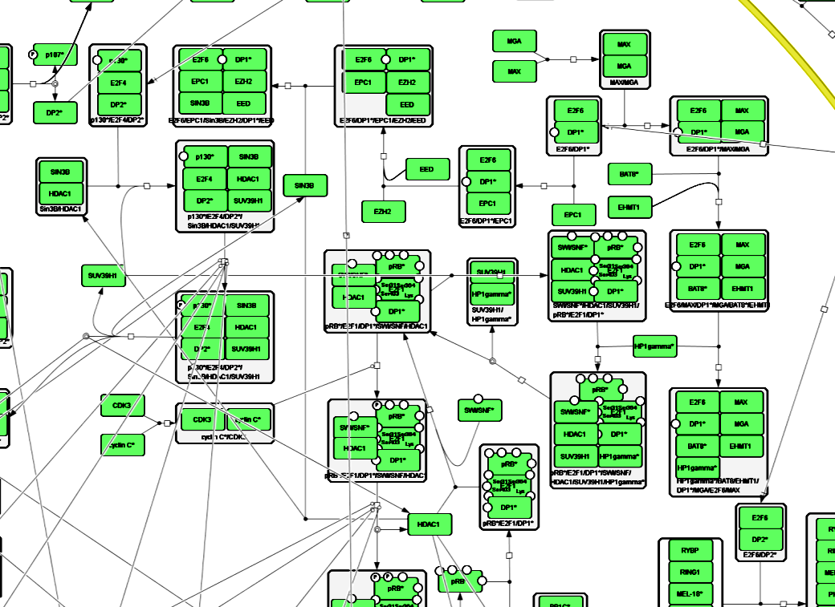
What is NaviCell
Web based environment for navigation, curation and maintenance of biochemical reaction networks

Slide 5
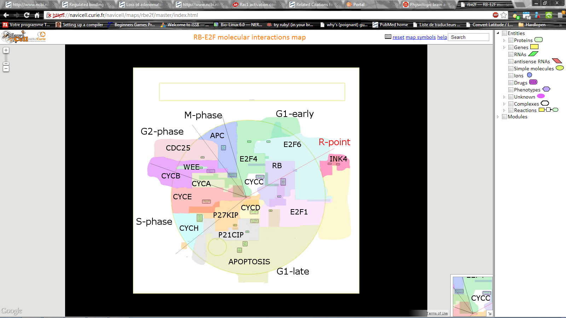
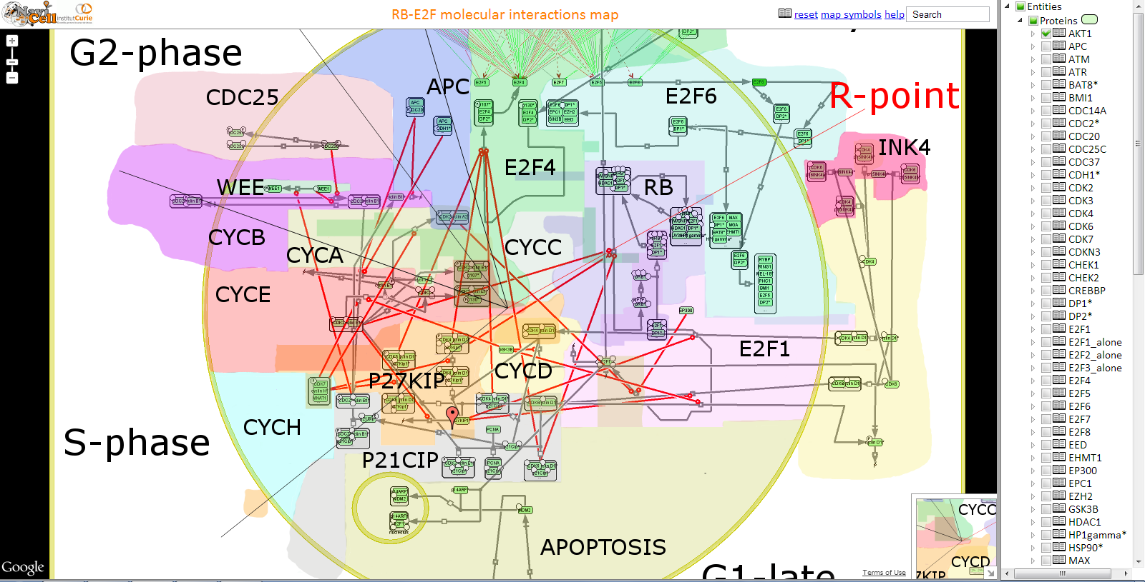
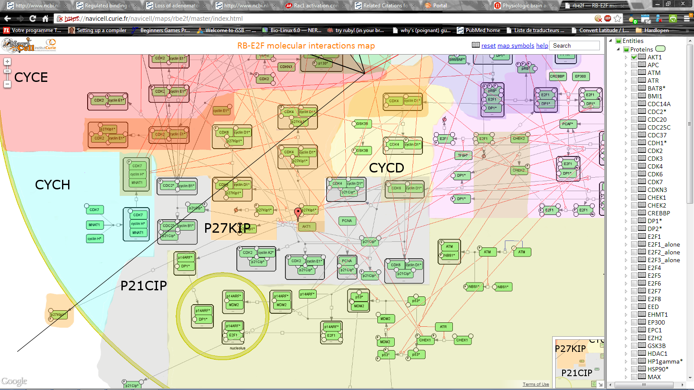
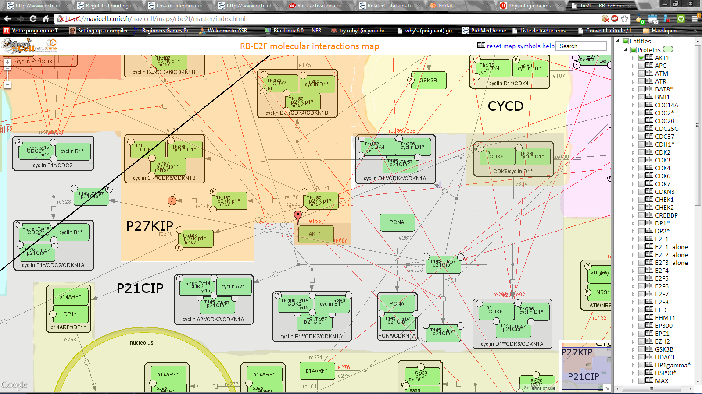
Based on Google Maps
Semantic zoom

Slide 6
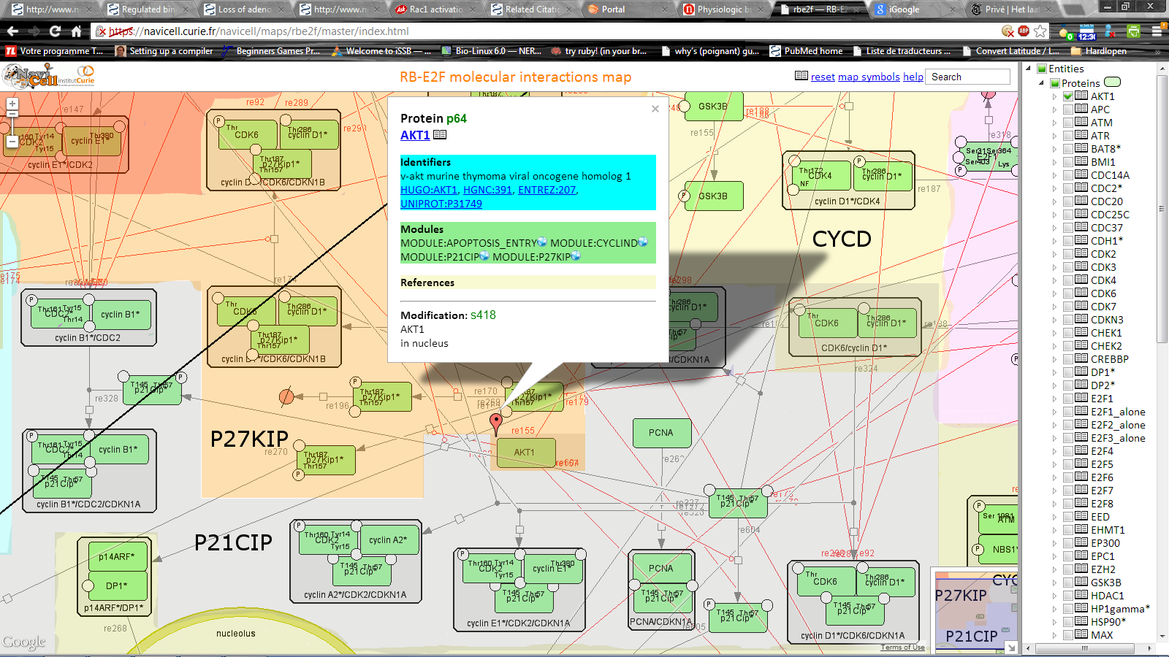
Pop-up Bubble
Blog
Module

Slide 7
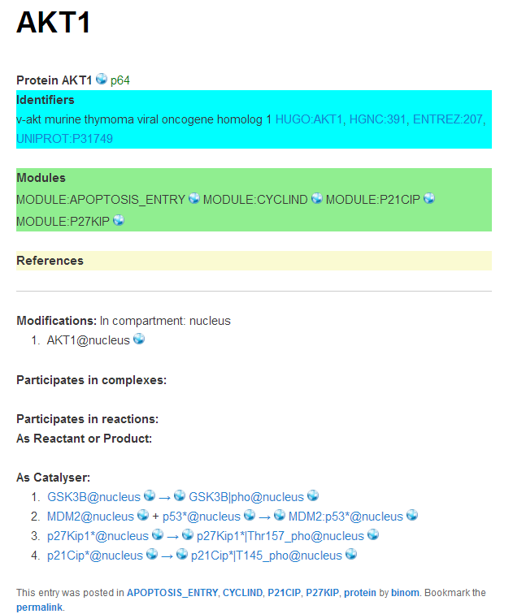
Blog view
Module view

Slide 8
Summary
Navigation
Blog system feedback and maintenance
Semantic zoom levels
http://navicell.curie.fr
http://goo.gl/BF34R
http://arxiv.org/abs/1301.7618.
Video Tutorial:
https://navicell.curie.fr/pages/tutorial.html

Slide 9
BiNom
Plug-in for Cytoscape
Bonnet et al. BMC Systems Biology 2013 7:18

Slide 10
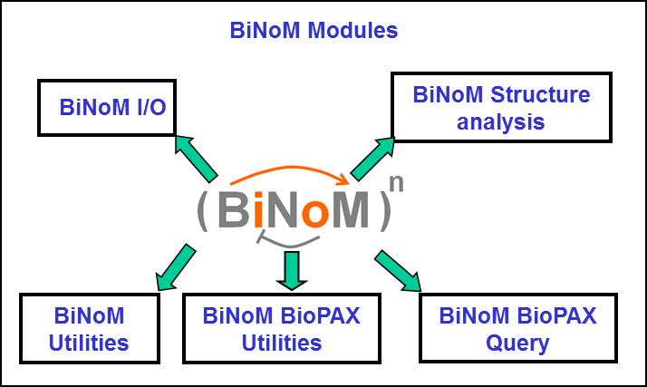
BiNoM, a Biological Network Manager
Facilitates the visualization and manipulation of biological networks.
Supports standard systems biology formats (BioPAX, CellDesigner, etc.).
Assists the user in the analysis of networks.
Extracts specific information from databases such as Reactome.

Slide 11
New Features
BioPAX level 3
Cytoscape 2.8
CellDesigner 4.3
Pathway Influence Quantification
Minimal Cut Set
Creation of interactive molecular maps

Slide 12
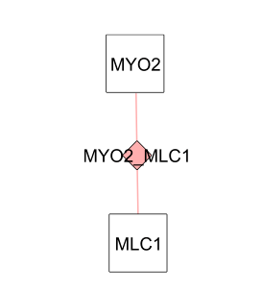
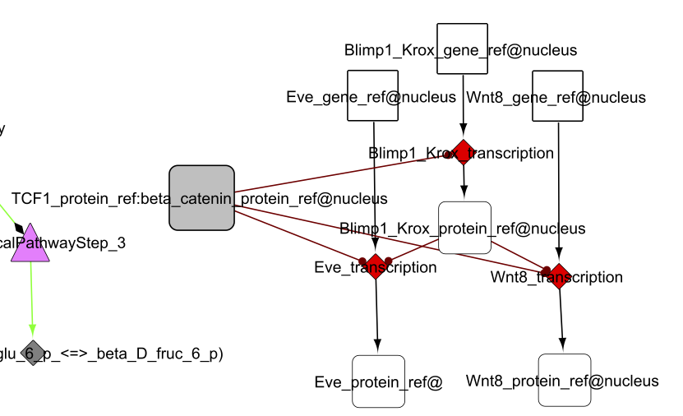
New BioPAX specifications
Genetic interaction
gene regulatory network

Slide 13
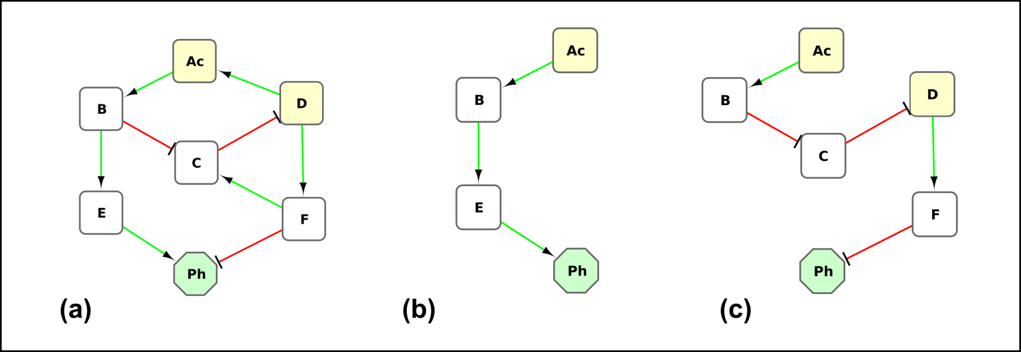
Pathway Influence Quantificattion
α: activity of path of the starting node
σ: sign of path
λ: length of path
q: number of paths

Slide 14
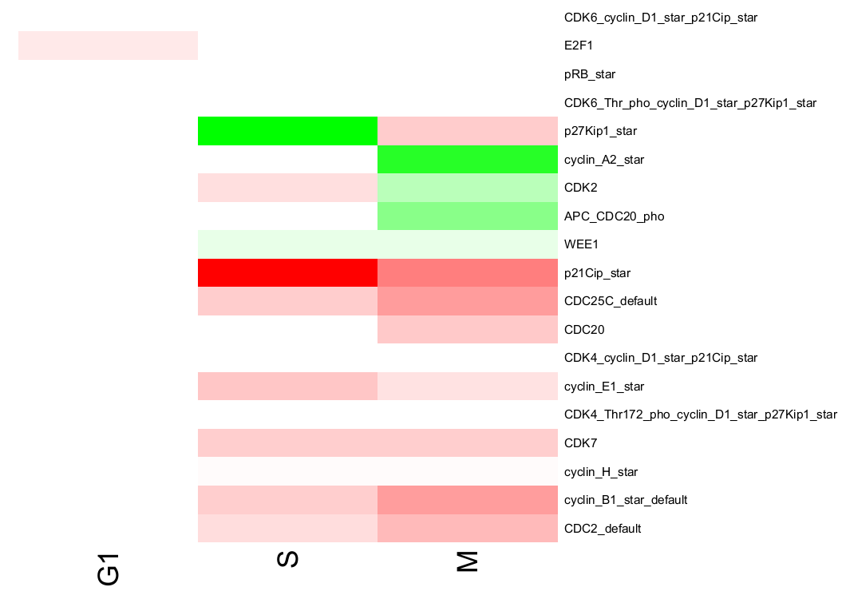
Example PIQUANT

Slide 15
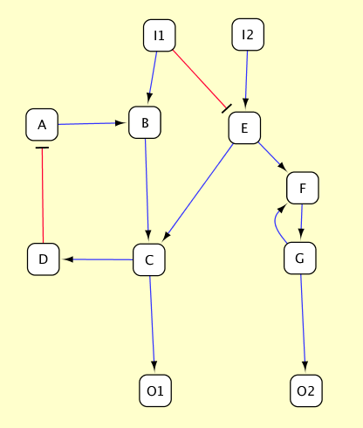
Minimal Cut Sets
I1 -> B -> C -> O1
I1 -> E -> C -> O1
I2 -> E -> C -> O1
Cut Set: {B,E}, {I1,I2], {C}
Defining novel drug targets

Slide 16
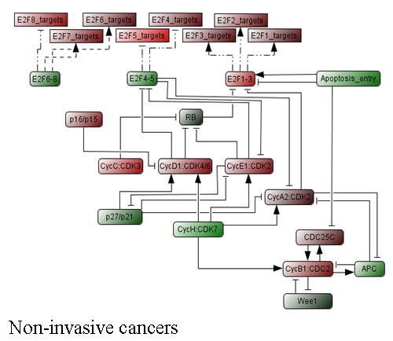
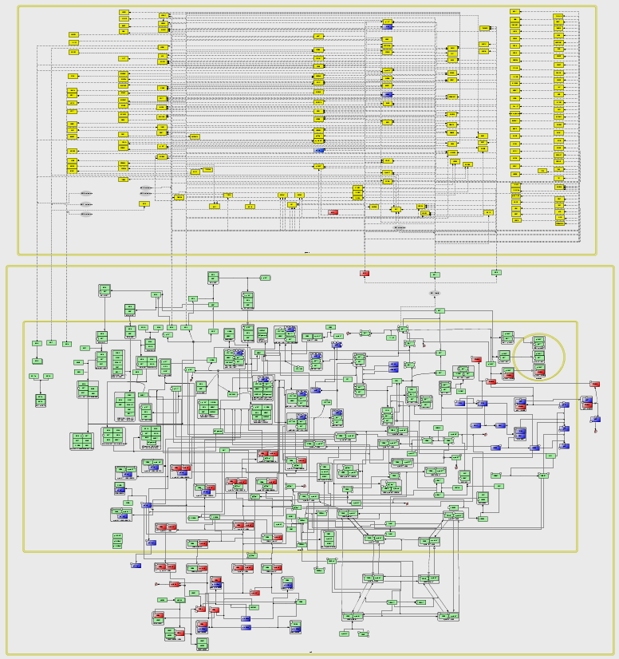
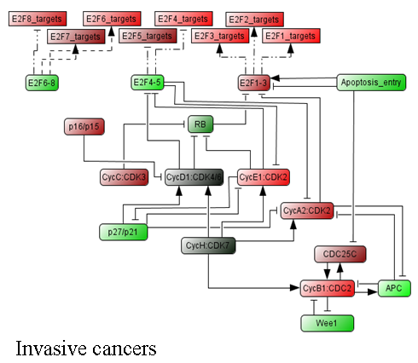
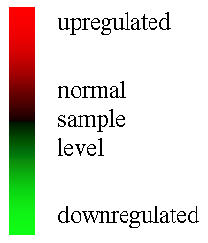
Colouring data

Slide 17
Staining background

Slide 18
Acknowledgements
Computational Systems Biology of Cancer*
*Equipe labellisée par la Ligue Nationale Contre le Cancer
Emmanuel Barillot
Eric Bonnet
Laurence Calzone
David Cohen
Simon Fourquet
Inna Kuperstein
Daniel Rovera
Gautier Stoll
Paula Vera-Licona
Stuart Pook
Hien Anh Nguyen
Andrei Zinovyev
Poster
104
navicell.curie.fr binom.curie.fr

